Slide 1

MANAGING AND QUERYING DATABASEB
NAME: K.BRINDHA
BATCH CODE: DA764S76
PROGRAM: DATASCIENCE AND ML WITH GENAI ADVANCED PROGRAM

Slide 2

SQL
Structured Query Language.

Slide 3
Library database
Member member_id(pk) name email(unique) phone
Activity_log log_id member_id(pk) book_id action acton_date
Librarian librarian_id(pk) name emial(unique)
issue record issue_is(pk) book_id(fk) member_id(fk) libratian_id(fk) issue_date return_date status
Book book_id(pk) title authore category_id available_copies
Category category_id(pk) category_name

Slide 4
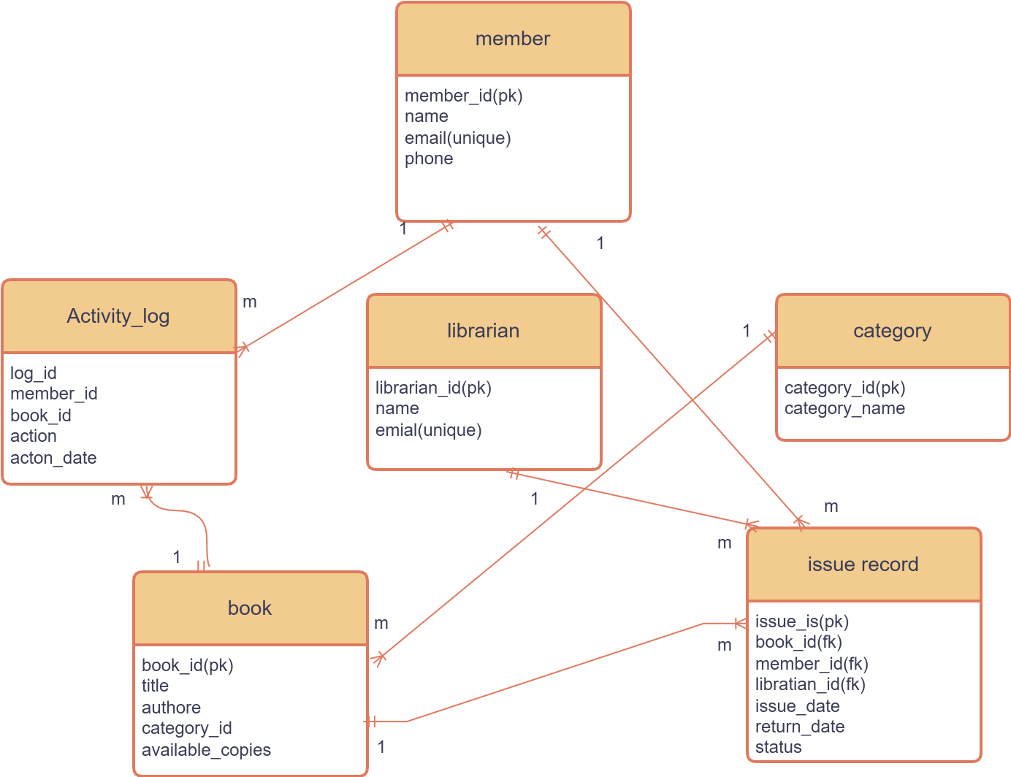
ER DIAGRAM -Entity-Relationship.

Slide 5


.?
CREATE DATABASES
USE THE DATABASE
CREATE THE TABLES
ADD CONSTRAINTS

Slide 6
Create the databases
CREATE DATABASE library_project_db;
Use the database
USE library_project_db;
Create the tables and constraints
CREATE TABLE Book ( book_id INT PRIMARY KEY AUTO_INCREMENT, title VARCHAR(150) NOT NULL, author VARCHAR(100), category_id INT, available_copies INT DEFAULT 1, FOREIGN KEY (category_id) REFERENCES Category(category_id));

Slide 7
CONSTRAINTS
PRIMARY KEY- A combination of NOT NULL and UNIQUE that uniquely identifies each row.
FOREIGN KEY- Prevents actions that would destroy links between tables.
UNIQUE KEY- Ensures all values in a column are duplicate.
CHECK- Validates that all values in a column satisfy a specific condition.
DEFAULT- Sets a fallback value for a column when no value is provided.
NOT NULL - Prevents a column from having a NULL value.

Slide 8
logical position select ,from , where , group by, having, order by ,limit
SELECT m.name, COUNT(i.issue_id) AS total_books FROM Member m
JOIN Issue_Record i ON m.member_id = i.member_idWHERE i.issue_date BETWEEN '2026-01-01' AND '2026-01-10'GROUP BY m.member_id, m.nameHAVING COUNT(i.issue_id) > 1ORDER BY total_books DESCLIMIT 5;
From
Where
Group by
Having
Select
Order by
Limit

Slide 9

JOINS
TYPES OF JOINS
INNER JOIN -Inner Join (Default): Returns rows with matching values in both tables.
OUTER JOIN
- LEFT JOIN -Left Join: Returns all rows from the left table and matched rows from the right.
- RIGHT JOIN- Right Join: Returns all rows from the right table and matched rows from the left.
FULL JOIN -Full Join: Returns all rows when there is a match in either table.

Slide 10
Inner join
SELECT m.name, b.title, a.action, a.action_dateFROM Activity_Log aINNER JOIN Member m ON a.member_id = m.member_idINNER JOIN Book b ON a.book_id = b.book_id;
Left outer join
SELECT b.title, i.issue_idFROM Book bLEFT JOIN Issue_Record i ON b.book_id = i.book_id;

Slide 11
Right outer join
SELECT m.name, i.issue_id, i.issue_dateFROM Member mRIGHT JOIN Issue_Record i ON m.member_id = i.member_id;
Full join
SELECT m.name, i.issue_idFROM Member mLEFT JOIN Issue_Record i ON m.member_id = i.member_idUNIONSELECT m.name, i.issue_idFROM Member mRIGHT JOIN Issue_Record i ON m.member_id = i.member_id limit 2;

Slide 12
Types of functions
Aggregate Functions: SUM(), AVG(), COUNT(), MIN(), MAX()
String functions - UPPER(), LOWER(), SUBSTRING(), CONCAT(),left(),right().
Data functions - NOW(), GETDATE(), DATEDIFF(), YEAR().

Slide 13
Aggregate Functions:
s
String function
select name, left(email,9) from member ;
Data formatting
select book_id,librarian_id,member_id, date_format(issue_date,'%M,%d,%y') as issue_date from issue_record;

Slide 14
Subqueries
Subqueries
A SQL subquery is a nested query within a main query, placed inside parentheses to perform operations like filtering, inserting, or updating data based on results from another table.

Slide 15
Scalar Subquery:
A scalar subquery is a subquery that selects only one column or expression and returns one row. A scalar subquery can be used anywhere in an SQL query that a column or expression can be used.
SELECT m.name, b.title, i.issue_dateFROM Issue_Record iJOIN Member m ON i.member_id = m.member_idJOIN Book b ON i.book_id = b.book_idWHERE i.issue_date = ( SELECT MAX(issue_date) FROM Issue_Record);

Slide 16
Tabular subquery
A tabular subquery (also known as a table subquery) returns a result set with multiple rows and columns and is typically used in the FROM or JOIN clauses of a SQL statement.
SELECT *FROM Issue_RecordWHERE (book_id, member_id) IN ( SELECT book_id, member_id FROM Issue_Record WHERE status = 'Issued');

Slide 17
Correlated Subquery
Correlated subqueries execute repeatedly Since the query runs once per outer query row, it can slow queries on large tables by rescanning inner data multiple times
SELECT nameFROM Member mWHERE ( SELECT COUNT(*) FROM Issue_Record i WHERE i.member_id = m.member_id) > 1;

Slide 18
SQL
DDL-(Data definition language)
create
alter
drop
rename
DML-(Data Manipulation language)
Insert
Update
delete
DRL/DQL-(Data query language/
Data Retrieval language)
select
DTL-(Data Transaction language)
Commit
rollback
Save point
DCL-(Data Control language)
Grant
Revoke

Slide 19
DDL-(Data definition language)
create:
CREATE TABLE Activity_Log ( log_id INT PRIMARY KEY AUTO_INCREMENT, member_id INT, book_id INT, action VARCHAR(50), action_date DATE, FOREIGN KEY (member_id) REFERENCES Member(member_id), FOREIGN KEY (book_id) REFERENCES Book(book_id));
Alter:
Modify
alter table member modify phone varchar(10);--
add constraint (unique)
ALTER TABLE MemberADD CONSTRAINT unique_email UNIQUE (email);
DROP:
alter table member drop aadhar_card;
RENAME
RENAME TABLE old_table_name TO new_table_name;

Slide 20

DRL/DQL-(Data query language/
Data Retrieval language)
Select the all records
select * from issue_record;
Select the particular records
select issue_id,member_id,status from issue_record;

Slide 21
DML-(Data Manipulation language)
INSERT:
INSERT INTO Librarian (name, email) VALUES('Lib1','lib1@mail.com'),('Lib2’,'lib2@mail.com'),('Lib3','lib3@mail.com’);
Update:
UPDATE Book SET available_copies = available_copies + 2WHERE available_c
Deleted:
DELETE FROM Issue_RecordWHERE status = 'Returned';opies < 3;

Slide 22
DCL-(Data Control language)
create role admin_librarian;
GRANT select,insert,update,delete on member to admin_librarian;
SELECT * FROM librarian;
GRANT 'admin_librarian' TO 'lib1mail.com’;
revoke admin_librarian from'lib1mail.com';

Slide 23
DTL-(Data Transaction language)
START TRANSACTION;
INSERT INTO Issue_Record (book_id, member_id, librarian_id, issue_date, status)
VALUES (1, 2, 1, CURDATE(), 'Issued’);
SAVEPOINT after_issue;
UPDATE BookSET available_copies = available_copies - 1WHERE book_id = 1;
ROLLBACK TO after_issue;
COMMIT;

Slide 24
ACID
1. Atomicity (All or Nothing)
A transaction must fully complete or fully fail
2. Consistency (Valid State)
Database must remain correct before and after transaction
3. Isolation (Transactions Don’t Interfere)’
Multiple transactions run independently
4. Durability (Permanent Storage)
Once committed → data is permanently saved

Slide 25
INDEX
In SQL, an index is a powerful database structure used to speed up data retrieval by providing a quick lookup mechanism for records instead of scaning every row in a table.
Performance Boost: Drastically reduces the time needed for SELECT,
WHERE, JOIN, Id_column ,primary key and ORDER BY operations.
CREATE INDEX idx_book_titleON Book(title);

Slide 26
LOCK
SHARED LOCK
“A shared lock allows multiple transactions to read a row but prevents any modification until the lock is released.”
START TRANSACTION;SELECT available_copiesFROM BookWHERE book_id = 1LOCK IN SHARE MODE;
Exclusive Lock
“An exclusive lock allows only one transaction to read and modify data, preventing all other transactions from accessing it until the lock is released.”
START TRANSACTION;
SELECT *FROM BookWHERE book_id = 1FOR UPDATE;
Dead lock
“A deadlock occurs when two or more transactions wait for each other’s resources, causing a cycle where none can proceed.”

Slide 27
Temporary Table
Exists only during the session
Is automatically deleted when the session ends
Used to store intermediate or temporary data
CREATE TEMPORARY TABLE temp_member_activity ASSELECT member_id, COUNT(*) AS total_issuesFROM Issue_RecordGROUP BY member_id;SELECT *FROM temp_member_activityWHERE total_issues > 2;
View
A VIEW is a virtual table based on a SQL query
CREATE VIEW view_issued_books ASSELECT m.name AS member_name, b.title AS book_title, i.issue_date, i.statusFROM Issue_Record iJOIN Member m ON i.member_id = m.member_idJOIN Book b ON i.book_id = b.book_id;

Slide 28
Stored Procedure
A Stored Procedure is a precompiled collection of one or more SQL statements that are saved and executed on a database server. Think of it as a reusable script or function within your database that allows you to perform complex tasks by calling a single command.
DELIMITER //CREATE PROCEDURE issue_book ( IN p_book_id INT, IN p_member_id INT, OUT p_message VARCHAR(100))BEGIN DECLARE copies INT; SELECT available_copies INTO copies FROM Book WHERE book_id = p_book_id; IF copies > 0 THEN INSERT INTO Issue_Record (book_id, member_id, issue_date, status) VALUES (p_book_id, p_member_id, CURDATE(), 'Issued'); UPDATE Book SET available_copies = available_copies - 1 WHERE book_id = p_book_id; SET p_message = 'Book Issued Successfully'; ELSE SET p_message = 'Book Not Available'; END IF;END //DELIMITER ;

Slide 29
TRIGGER
A trigger in SQL is a special type of stored procedure that automatically executes (or "fires") in response to specific events on a table or view. Unlike standard Stored Procedures, which must be called manually by a user, triggers are managed by the database engine and run in the background when data is modified
DELIMITER //CREATE TRIGGER trg_after_returnAFTER UPDATE ON Issue_RecordFOR EACH ROWBEGIN IF NEW.status = 'Returned' THEN UPDATE Book SET available_copies = available_copies + 1 WHERE book_id = NEW.book_id; END IF;END //DELIMITER ;

Slide 30
THANK YOU

